Slide 1
Run Together
CS 440 Coding project description

Slide 2
Project Description:
440 Coding project description
CS 440 Coding project description
Run Together! is a running app with a concentration on social interactions. It is meant to be used by users who participate in group running to communicate with friends and it allows them to also track their running data.
Users can find friends through the app
Then from the app, users can schedule runs with their friends and groups though the chat poll features.
The app focuses on synchronous group activities, but it also allows users to run in individually so users can use the same app everyday.
By being able to run with friends, users will be able to reach their running goals by holding each other accountable to a schedule.

Slide 3
What we did:
We have created a Login/Sign-up feature to access the app.
We have created a database which store the information of users and texts between the users.
We have made the text user, individual run, and add friends functionalities

Slide 4
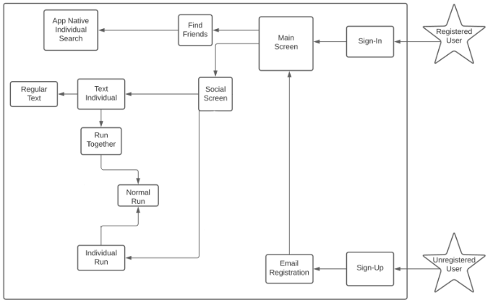
Functionality of app

